Slide 1
Product Analytics and Pricing Trends in Flipkart E-Commerce Using DBMS
B.Sc. (Applied Statistics & Analytics)
Group Members :
Mentor:
Dr. Kavita Jain
Sameer Bhavnani – A024
Khushi Sahni – A040

Slide 2
INDEX
Sr. No. | Topic | Page No. | Sr. No. | Topic | Page No.
1 | RoadMap | 3 | 8 | Conclusion | 27
2 | Introduction | 4 | 9 | Future Scope of Study | 29
3 | Objectives | 5 | 10 | Bibliography | 30
4 | ER Diagram | 6
5 | Schema | 7-9
6 | Relational Tables | 10-18
7 | SQL Queries | 19-26

Slide 3
ROADMAP
RELATIONAL TABLES
INTRODUCTION
OBJECTIVES
ER DIAGRAM
FUTURE SCOPE
CONCLUSION
QUERIES

Slide 4
INTRODUCTION
A Database Management System (DBMS) is software that allows users to store, manage, and retrieve data efficiently. It ensures data integrity, security, and organized access.
Flipkart stands as a leading platform where product pricing, customer preferences, and purchasing trends constantly evolve. Analyzing these patterns is crucial for businesses to optimize pricing strategies, enhance customer satisfaction, and improve sales performance.
By structuring data into relational tables and performing meaningful queries, we can extract valuable insights such as: Pricing Trends, Customer Preferences , Seller Performance, Market Competitiveness
By utilizing SQL-based queries and data analytics, this project provides a data-driven approach to enhancing e-commerce decision-making, enabling Flipkart and its stakeholders to refine pricing strategies, improve user engagement, and drive business growth.

Slide 5
OBJECTIVE
1. To identify top customers and their spending patterns.
2. To analyze order hotspots and monthly sales shifts.
3. To find best-sellers, top-rated items, and common purchase quantities.
4. To assess product availability and average order value.
5. To track review activity and highest-rated products.
6. To detect missing payment details for accuracy.
7. To evaluate price trends and category-wise pricing insights.
8. To ensure data completeness by identifying missing product images.

Slide 6
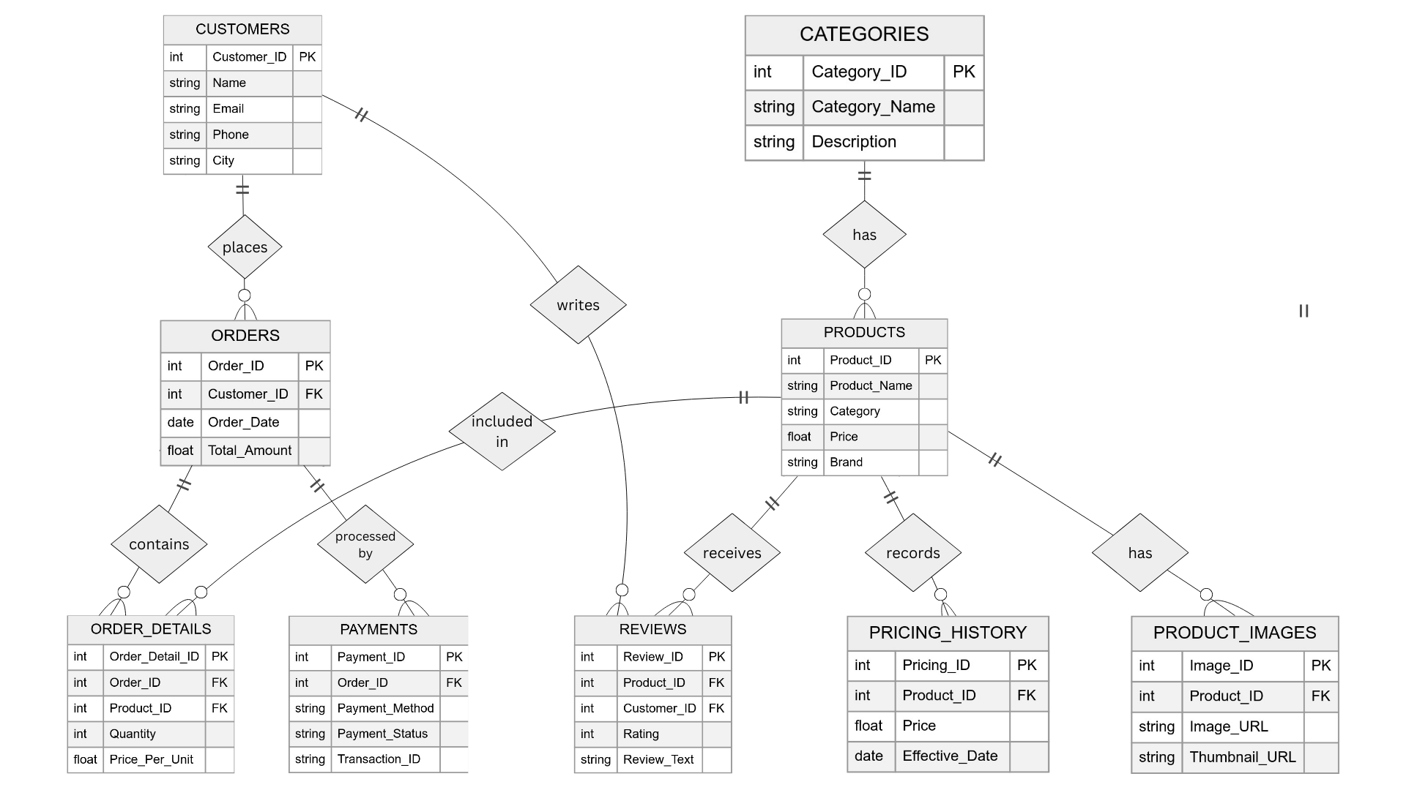
ER DIAGRAM

Slide 7
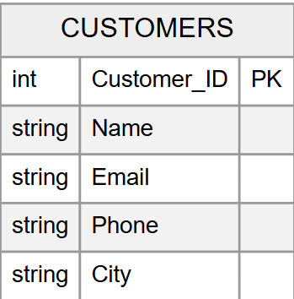
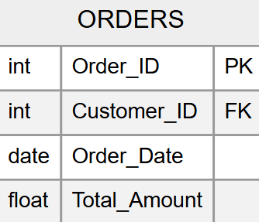
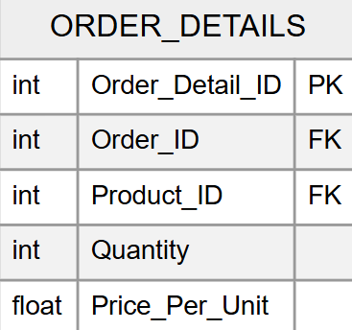
SCHEMA

Slide 8
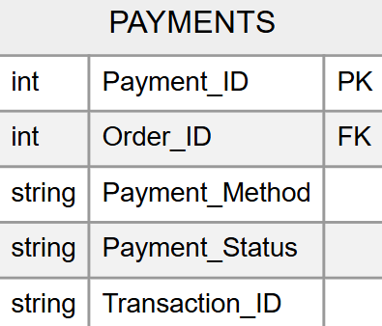
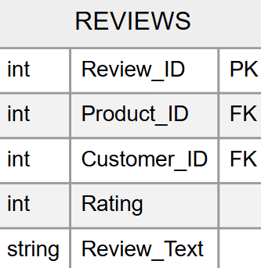
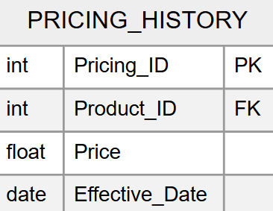
SCHEMA

Slide 9
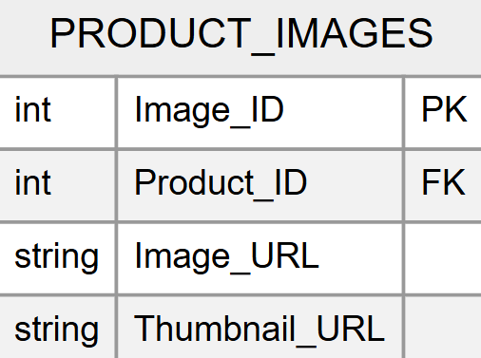
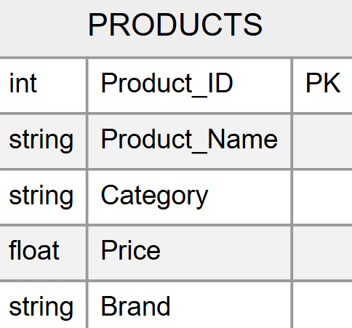
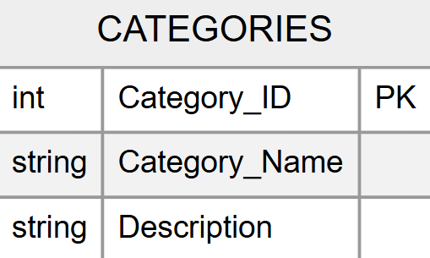
SCHEMA

Slide 10
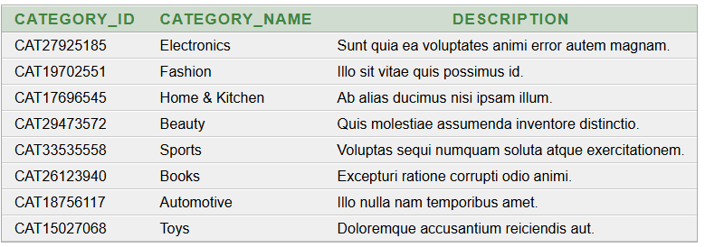
RELATIONAL TABLES
1. CATEGORIES
SELECT * FROM CATEGORIES1

Slide 11
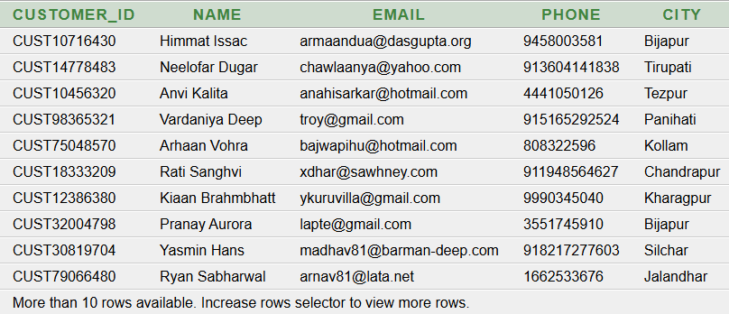
RELATIONAL TABLES
2. CUSTOMERS
SELECT * FROM CUSTOMERS1

Slide 12
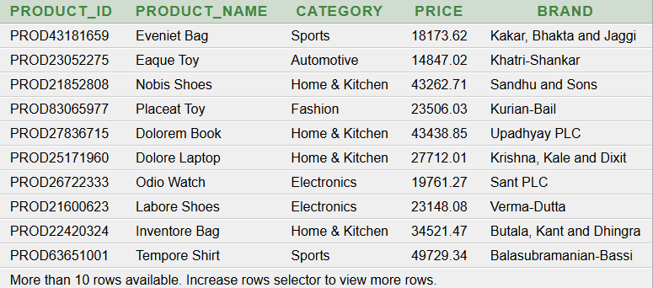
RELATIONAL TABLES
3. PRODUCT
SELECT * FROM PRODUCT1

Slide 13
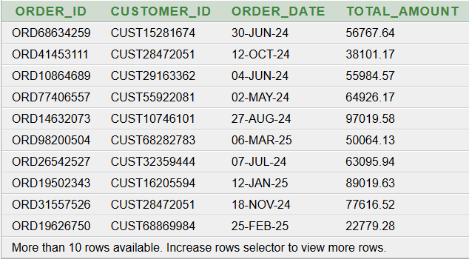
RELATIONAL TABLES
4. ORDER
SELECT * FROM ORDER1

Slide 14
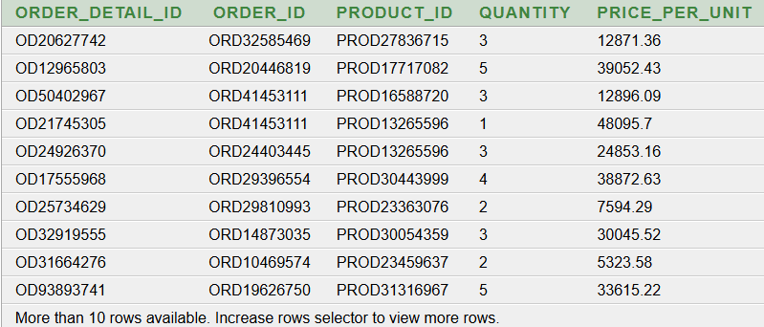
RELATIONAL TABLES
5. ORDER DETAIL
SELECT * FROM ORDER_DETAILS1

Slide 15
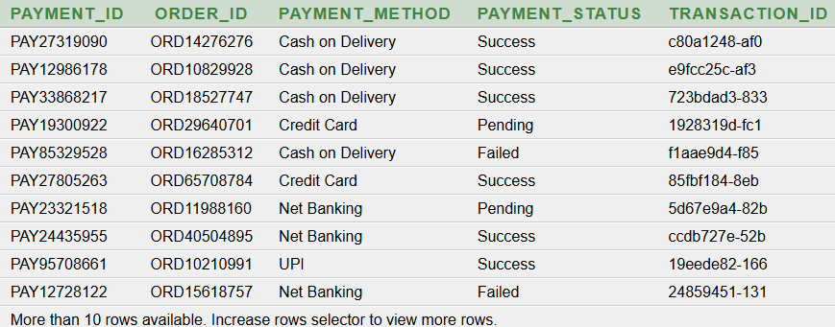
RELATIONAL TABLES
6. PAYMENT
SELECT * FROM PAYMENTS1

Slide 16
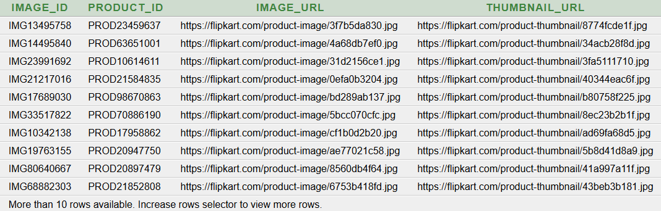
RELATIONAL TABLES
7. PRODUCT IMAGES
SELECT * FROM PRODUCT_IMAGES1

Slide 17
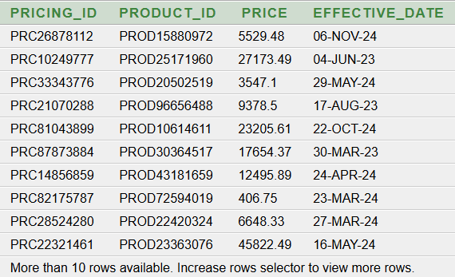
RELATIONAL TABLES
8. PRICING HISTORY
SELECT * FROM PRICING_HISTORY1

Slide 18
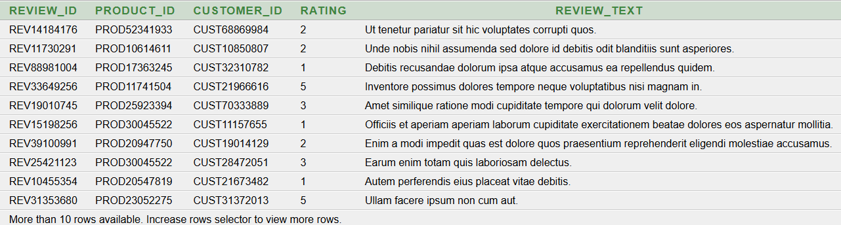
RELATIONAL TABLES
9. REVIEWS
SELECT * FROM REVIEWS1

Slide 19

SQL QUERIES
Find the City with the Highest Number of Orders
INPUT:
SELECT City, Order_Count
FROM (
SELECT C.City, COUNT(O.Order_ID) AS Order_Count
FROM ORDER1 O
JOIN CUSTOMERS1 C ON O.Customer_ID = C.Customer_ID
GROUP BY C.City
ORDER BY Order_Count DESC
) WHERE ROWNUM = 1;
OUTPUT:

Slide 20

SQL QUERIES
Find the Most Frequently Purchased Quantity in Customer Orders
INPUT
SELECT Quantity, Frequency
FROM (
SELECT Quantity, COUNT(*) AS Frequency
FROM ORDER_DETAILS1
GROUP BY Quantity
ORDER BY Frequency DESC
) WHERE ROWNUM = 1;
OUTPUT:

Slide 21
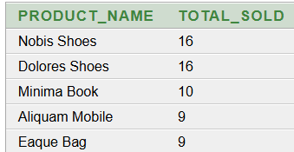
SQL QUERIES
Find the Top 5 Best-Selling Products Based on Quantity Sold
INPUT: OUTPUT:
SELECT Product_Name, Total_Sold
FROM (
SELECT P.Product_Name, SUM(OD.Quantity) AS Total_Sold
FROM ORDER_DETAILS1 OD
JOIN PRODUCT1 P ON OD.Product_ID = P.Product_ID
GROUP BY P.Product_Name
ORDER BY Total_Sold DESC
) WHERE ROWNUM <= 5;

Slide 22

SQL QUERIES
Find the Total Number of Products Sold in the Last Month
INPUT:
SELECT SUM(OD.Quantity) AS Total_Products_Sold
FROM ORDER_DETAILS1 OD
JOIN ORDER1 O ON OD.Order_ID = O.Order_ID
WHERE O.Order_Date >= ADD_MONTHS(SYSDATE, -1);
OUTPUT:

Slide 23
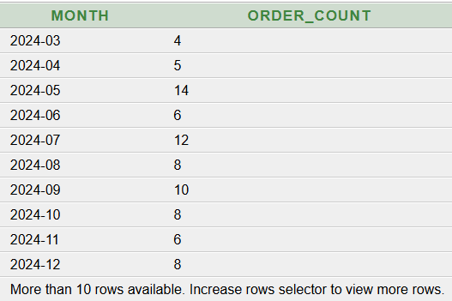
SQL QUERIES
Analyze the Monthly Trend in Order Volume Over the Last Year
INPUT: OUTPUT:
SELECT TO_CHAR(O.Order_Date, 'YYYY-MM') AS Month, COUNT(O.Order_ID) AS Order_Count
FROM ORDER1 O
WHERE O.Order_Date >= ADD_MONTHS(SYSDATE, -12)
GROUP BY TO_CHAR(O.Order_Date, 'YYYY-MM')
ORDER BY Month;

Slide 24

SQL QUERIES
Identify the Highest-Rated Product Based on Customer Reviews
INPUT: OUTPUT:
SELECT Product_Name, Avg_Rating
FROM (
SELECT P.Product_Name, AVG(R.Rating) AS Avg_Rating
FROM REVIEWS1 R
JOIN PRODUCT1 P ON R.Product_ID = P.Product_ID
GROUP BY P.Product_Name
ORDER BY Avg_Rating DESC
) WHERE ROWNUM = 1;

Slide 25

SQL QUERIES
Identify Customers Who Have Submitted More Than 5 Reviews
INPUT:
SELECT Customer_Name, Review_Count FROM (
SELECT C.NAME AS Customer_Name, COUNT(R.REVIEW_ID) AS Review_Count
FROM CUSTOMERS1 C
JOIN REVIEWS1 R ON C.CUSTOMER_ID = R.CUSTOMER_ID
GROUP BY C.NAME
ORDER BY Review_Count DESC
) WHERE ROWNUM = 1;
OUTPUT:

Slide 26
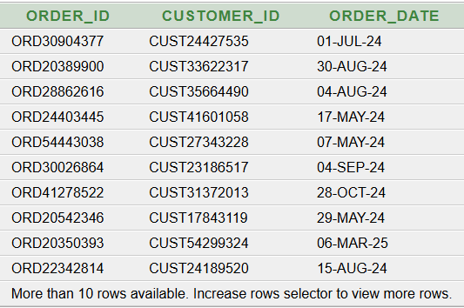
SQL QUERIES
Find Orders That Lack Corresponding Payment Details
INPUT: OUTPUT:
SELECT O.Order_ID, O.Customer_ID, O.Order_Date
FROM ORDER1 O
LEFT JOIN PAYMENTS1 P ON O.Order_ID = P.Order_ID
WHERE P.Payment_ID IS NULL;

Slide 27
CONCLUSION
Analysis of Flipkart's e-commerce data reveals key insights into product performance, customer preferences, and pricing trends.
Top-selling products and categories highlight key areas driving sales.
Customer reviews help identify the best and worst-rated products.
Certain cities and customers contribute significantly to overall orders, indicating strong regional demand.
Pricing history showcases trends and fluctuations, helping optimize pricing strategies.
Most preferred payment methods provide guidance on enhancing transaction efficiency.
Insights can help improve customer experience, boost sales, and refine pricing for better profitability.

